Slide 1

Incentivizing Cooperation and Community Formation in Social Internet of IoT Networks: A study on Virtual Currencies and social Behaviors
Name: Saood Iqbal
(Registration No. CS420212002)
PhD Scholar
Institute of Computing
Kohat University of Science and Technology
Supervisors
Dr. Shafi Ullah Khan
Professor
Institute of Computing, KUST
Dr. M. Muneer Umar
Lecturer
Institute of Computing, KUST

Slide 2
Outline
Introduction
Literature Review
Problem statement
Research Objectives
Proposed Methodology
References

Slide 3









Introduction
IoT
The Internet of Things (IoT) is the network of physical objects or "things” connected to the internet with the ability to collect and exchange information from user or environment with no human intervention.
The devices are
Embedded with electronics, software, sensor.
Sensors like smart refrigerator
Smart air conditioner
Smart household things
Security system
IoT
1
Notes:
The Internet of Things (IoT) is the network of physical objects or "things" embedded with electronics, software, sensors, and network connectivity, which enables these objects to collect and exchange data without requiring human-to-human or human-to-computer interaction.”

Slide 4
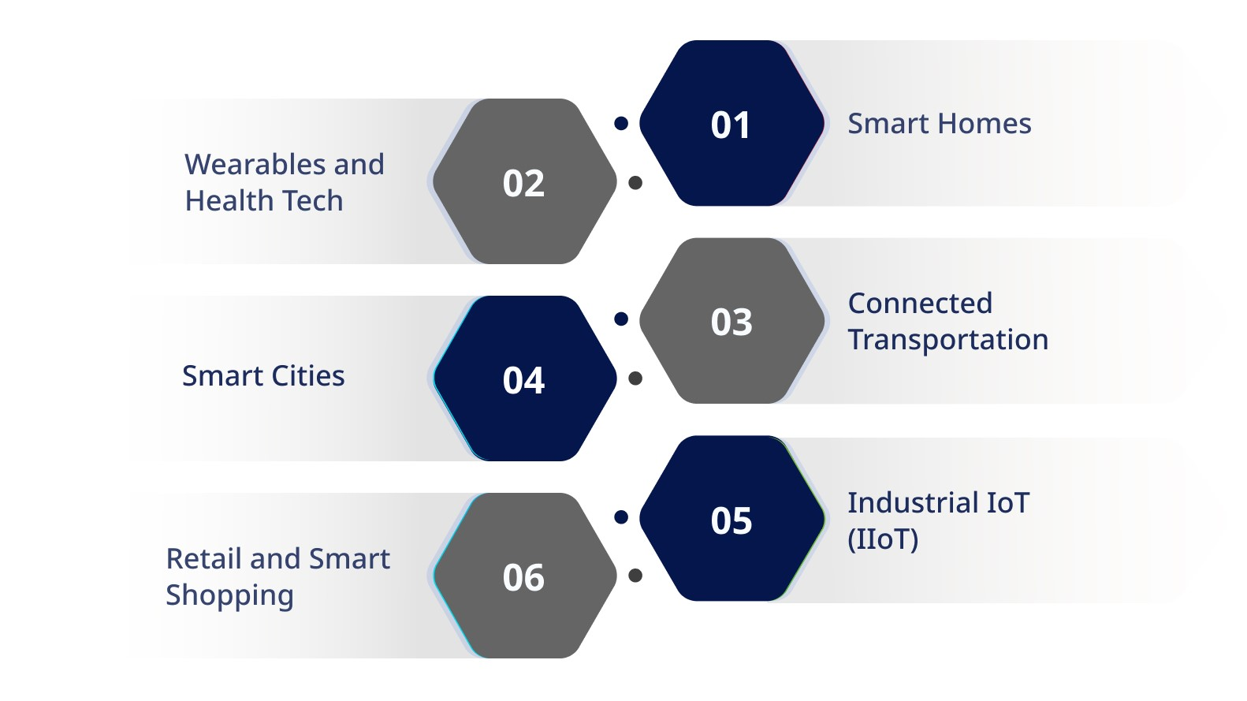
Applications of IoT
2

Slide 5
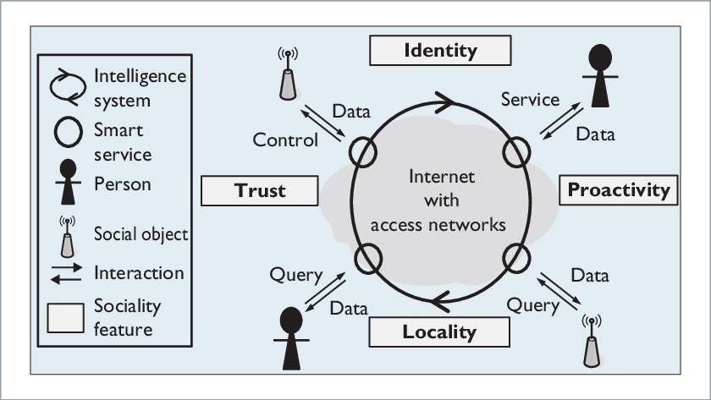
SOCIAL IoT
Converting smart objects to social objects
Introduce social behavior in the objects
To mange communication between social networks and Internet of Things
Social IoT improves the efficiency of a node .
D. Hussein et al.[2]
Institute of Computing, Kohat University of Science & Technology, Kohat
3
Notes:
IOT introduces a new field called SIOT. It is now an interesting area in the research community. SIOT is my field of interest. where objects established social connection with other objects. If we see over here the diagram, we have sociality features that represent the social behavior within the SIOT. 1. to grant access 2. providing or receiving services 3.Relationship/interaction 4. Trustworthiness.

Slide 6
LITERATURE REVIEW
Article | Contribution | Limitations
Li Li et al.[8], 2016. 8th IC on (WCSP), IEEE. | The scheme applied a bargaining game. Virtual Currency is used for calculation. The nodes resources and social ties are considered for data transmission. | Mobility and reliability is not considered.. They do not consider the common interactions among community nodes.
Jedari et al.[9], 2017. Future Generation Computer System ELSEVIER. | This scheme use incentive to enhance cooperation.. The nodes aim to maximize their credit by exchanging messages while rotating offers to determine the price. A good data delivery ratio and delay in the presence of selfish nodes. | This work is basically encouraging cooperation amongst the nodes but not considering the node energy. No community is created.
4
Notes:
This is the representation of literature review. I studies the literature. And the last column we mentioned the major limitation that we identified.P#1 GT and VC are used. Resources are considered for data transmission. Mobility and reliability. Common connection among the community nodes are not considered. P#2 GT and credit based , good data delivery and delay in the presence of selfish node. Encouraging node cooperation It do not consider energy of nodes..

Slide 7
Contd…
Article | Contribution | Limitations
Jedari et al.[10], 2019. Future Generation Computer System ELSEVIER | Social-based watchdog System (SoWatch) identifies the node’s behaviour based on social information. It calculates the node’s reputation through indirect method. They analyses the information to detect the node as selfish or trustworthy. | Misbehaviour nodes are only detected. No punishment and incentives offered to misbehaviour nodes.
Umar et al.[11], 2018. IEEE Access. | They proposed incentive based scheme to stimulate the selfish nodes in a wireless sensor network. The nodes used various parameters for designing the virtual currency referred to as scores. | The work mainly focuses on the sensor networks and the social aspects are not considered.
5
Notes:
P#3. Social Connection, Reputation Score. Selfish /Trustworthy. No Punishment/ No Incentive
P#4. GT,WSN,VC used various generic parameters. Social aspects are not considered.

Slide 8
Contd…
Article | Contribution | Limitations
Rehman et al.[12], 2019. Europeon Transactions on Telecommunications (ETT), John Willay &Sons Ltd. | Detecting selfish behaviour of nodes and omitting it through elected heads using election process. Nodes are punished after repeated selfish behavior. | Overhead of election process No isolation of selfish nodes.
Muhammad et al.[13], 2023. Applied Sciences MDPI. | Mainly focuses on the formation of nodes have adequate level of credibility, among others. The main objective is to focus on the separation of Honest nodes from others. | It is mainly based on the interaction frequency among nodes. The scheme use honesty a single parameter other vital parameters are not considered.
6
Notes:
P#5. Election Based. Detect selfish behavior. But overhead of election process, No Isolation of nodes, No community is created.
P#6. Creditable community, honesty but interaction Frequency, and other important parameters are not considered.

Slide 9
PROBLEM STATEMENT
Social Internet of Things has the potential to connect smart objects in the community. Each node has social attributes which should be considered while formatting the communities between them.
Nodes may not cooperate to forward data to preserve their resources ( Such as Energy, Bandwidth, Space etc). Therefore, Selfish behavior of nodes degrade the performance of a network.
The existing mechanisms mainly focus on the generic aspects of IoT and do not consider the important social factors.
There is a need of mechanism that may address the preference factor of the nodes based on source incentive within the structured community, to stimulate selfish nodes.
.
7
Notes:
Based on the literature we formulate the problem statement.

Slide 10
RESEARCH OBJECTIVES
To develop a mechanism for smart node community formation in SIoT, based on node preference factors.
To design an incentives-based mechanism to stimulate selfish nodes in the network.
To utilized and formulate the social aspects of nodes to achieve the true spirit of SIoT and other related networks.
8
Notes:
These are our research objective.

Slide 11
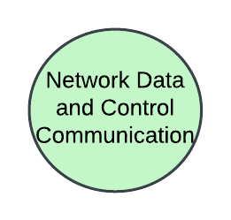
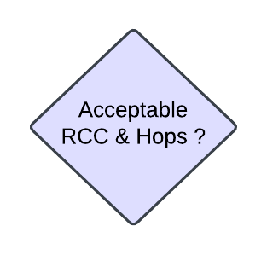
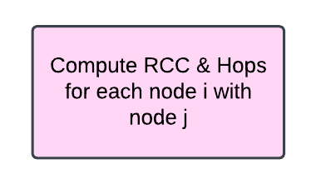
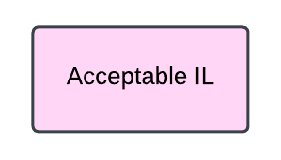
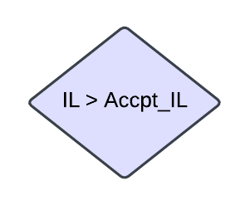
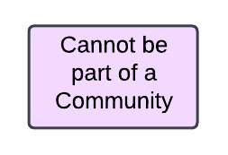
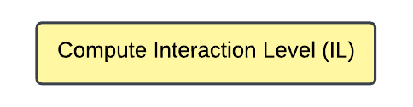
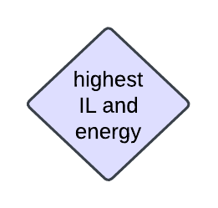
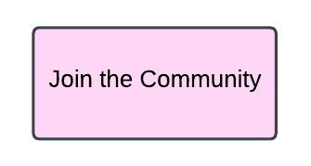
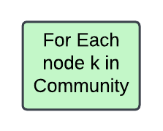
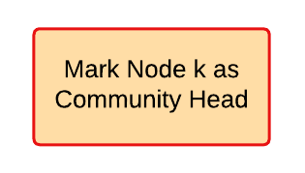

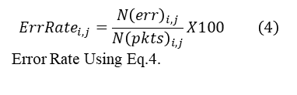


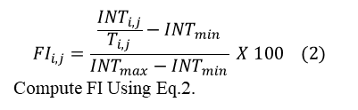
PROPOSED METHODOLOGY
$$RCC_{i,j}=\frac{{CommConn}_{i,j}}{{AllConn}_{i}+{AllConn}_{j}−{CommConn}_{i,j}} (1)$$
Community Formation Module:
$${FI}_{i,j}=\frac{\frac{{INT}_{i,j}}{T_{i,j}}−I{NT}_{min}}{{INT}_{max}−{INT}_{min}} X 100 (2)$$
Compute FI Using Eq.2.
Compute FI, Latency, Error Rate
$${Latency}_{i,j}=\frac{{TotalLatency}_{i,j}−MinLatency}{MaxLatency−MinLatency} X 100 (3)$$
Compute Latency Using Eq.3.
$${ErrRate}_{i,j}=\frac{{N\left(err\right)}_{i,j}}{{N\left(pkts\right)}_{i,j}}X100 \left(4\right)$$
Error Rate Using Eq.4.
$IL_{i,j}=\frac{w_{1}IF_{i,j}}{{w_{2}ErrRate}_{i,j}+{w_{3}Latency}_{i,j}} (5)$
9
Notes:
Here are our proposed methodology. Our proposed work is divided into two module. Community formation Now I am explaining the process of community formation.in this process I will show you how community are formed and how community head are selected. So we are starting with continuous network data and control communication. Suppose we have two nodes I and j whenever they want to be a part of single community. So, they must go to these steps. So first of all, it is checked whether the nodes are nearby. For that purpose, we are calculating hops count. We also checked the nodes have some sort of connection for these we checked RCC. We have formula for RCC. The nodes hop count and RCC is checked with the defined values.

Slide 12
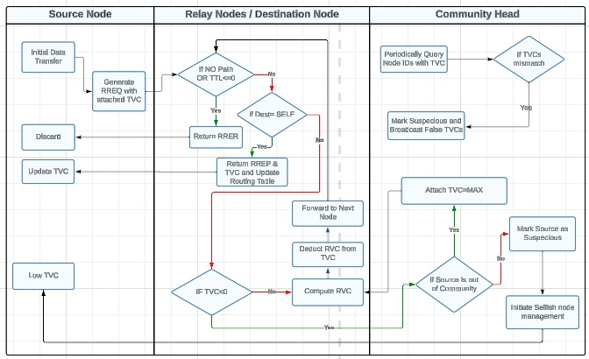
DESIGN INCENTIVE MODULE
Figure 2. TVC-based traffic management in the network
10
Institute of Computing, Kohat University of Science & Technology, Kohat

Slide 13

COMMUNITY HEAD SELECTION
Parameters considered for the selection of Community Head
Interaction Level: Frequency of a node in the community.
Energy level: A node with more energy level can actively take part in network activities.
Institute of Computing, Kohat University of Science & Technology, Kohat
11

Slide 14
ROLE OF SELECTED COMMUNITY HEAD (SCH)
To stimulate selfish node
To Mange VC in the network.
Monitors the network to identify selfish behavior of node if TVC not mismatch.
To verify the TVCs from its neighbor nodes.
To validate the useful communication using feedback.
12

Slide 15
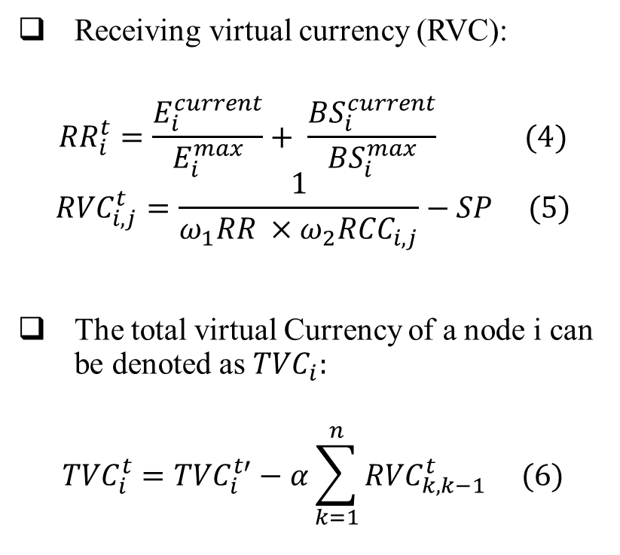
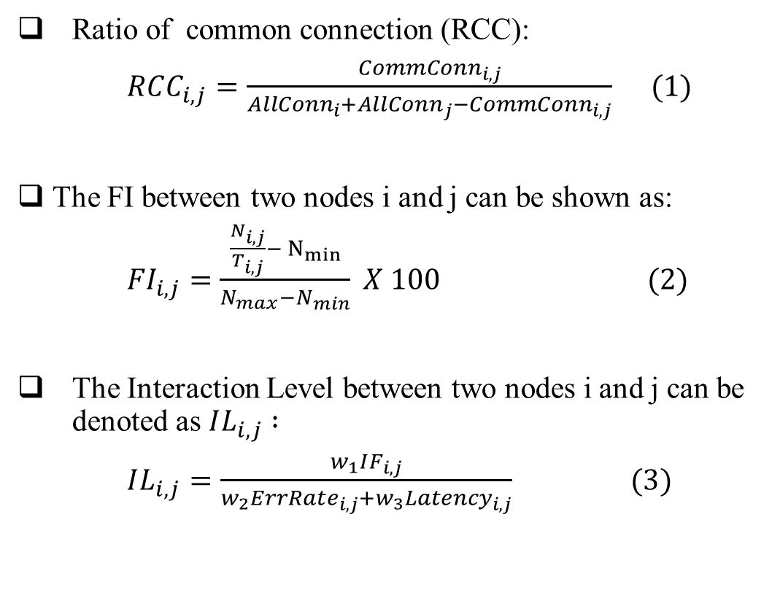
Equations for RCC and IL Calculation:
Equations for RVCs and TVCs Calculation:
Ratio of common connection (RCC):
$RCC_{i,j}=\frac{{CommConn}_{i,j}}{{AllConn}_{i}+{AllConn}_{j}−{CommConn}_{i,j}} (1)$
The FI between two nodes i and j can be shown as:
${FI}_{i,j}=\frac{\frac{N_{i,j}}{T_{i,j}}− N_{min}}{N_{max}−N_{min}} X 100 (2)$
The Interaction Level between two nodes i and j can be denoted as $IL_{i,j}$ $:$
$IL_{i,j}=\frac{w_{1}IF_{i,j}}{{w_{2}ErrRate}_{i,j}+{w_{3}Latency}_{i,j}} (3)$
Receiving virtual currency (RVC):
$${RR}_{i}^{t}=\frac{E_{i}^{current}}{E_{i}^{max}}+ \frac{{BS}_{i}^{current}}{{BS}_{i}^{max}} (4)$$
$${RVC}_{i,j}^{t}=\frac{1}{ω_{1}RR ×ω_{2}{RCC}_{i,j}}−SP (5)$$
The total virtual Currency of a node i can be denoted as ${TVC}_{i}:$
$${TVC}_{i}^{t}={TVC}_{i}^{t′}−α\sum_{k=1}^{n}{{RVC}_{k,k−1}^{t} (6)}$$
13

Slide 16
TIME FRAME:
S.No. | Research Component | Time Required
1 | Literature Review | Three months
2 | System Design | Two months
3 | Simulation | Three months
4 | Thesis Writings | Four months

Slide 17
REFERENCES:
[1] Y. Perwej, M. A. AbouGhaly, B. Kerim, and H. A. M. Harb, "An extended review on internet of things (iot) and its promising applications," Communications on Applied Electronics (CAE), ISSN, pp. 2394-4714, 2019.
[2] Hussein, D., et al. (2015). &quot;Dynamic social structure of things: A contextual approach in CPSS.&quot; IEEE
Internet Computing 19(3): 12-20.
[2] L. Atzori, A. Iera, G. Morabito, and M. Nitti, "The social internet of things (siot)–when social networks meet the internet of things: Concept, architecture and network characterization," Computer networks, vol. 56, no. 16, pp. 3594-3608, 2012.
[3] W. Abdelghani, C. A. Zayani, I. Amous, and F. Sèdes, "Trust evaluation model for attack detection in social internet of things," in Risks and Security of Internet and Systems: 13th International Conference, CRiSIS 2018, Arcachon, France, October 16–18, 2018, Revised Selected Papers 13, 2019: Springer, pp. 48-64.
[4] A. M. Kowshalya and M. Valarmathi, "Community detection in the social internet of things based on movement, preference and social similarity," Stud. Inf. Control, vol. 25, pp. 499-506, 2016.
[5] M. Malekshahi Rad, A. M. Rahmani, A. Sahafi, and N. N. Qader, "Community detection and service discovery on Social Internet of Things," International Journal of Communication Systems, vol. 36, no. 11, p. e5501, 2023.
[6] S. Nobahary and S. Babaie, "A Credit-based Method to Selfish Node Detection in Mobile Ad-hoc Network," Appl. Comput. Syst., vol. 23, no. 2, pp. 118-127, 2018.

Slide 18
References:
[7] S. A. Siddiqui, A. Mahmood, Q. Z. Sheng, H. Suzuki, and W. Ni, "A survey of trust management in the internet of vehicles," Electronics, vol. 10, no. 18, p. 2223, 2021.
[8] L. Li, Y. Qin, X. Zhong, and H. Chen, "An incentive aware routing for selfish opportunistic networks: A game theoretic approach," in 2016 8th International Conference on Wireless Communications & Signal Processing (WCSP), 2016: IEEE, pp. 1-5.
[9] B. Jedari, L. Liu, T. Qiu, A. Rahim, and F. Xia, "A game-theoretic incentive scheme for social-aware routing in selfish mobile
social networks," Future Generation Computer Systems, vol. 70, pp. 178-190, 2017.
[10] B. Jedari, F. Xia, H. Chen, S. K. Das, A. Tolba, and Z. Almakhadmeh, “A social-based watchdog system to detect selfish nodes in opportunistic mobile networks,” Future Generation Computer Systems, vol. PP, no. 99, pp. 1–1, 2019.
[11] M. M. Umar, S. Khan, R. Ahmad, and D. Singh, "Game theoretic reward based adaptive data communication in wireless sensor networks," IEEE Access, vol. 6, pp. 28073-28084, 2018.
[12] G. u. Rehman, A. Ghani, M. Zubair, S. A. Ghayyure, and S. Muhammad, "Honesty based democratic scheme to improve community cooperation for Internet of Things based vehicular delay tolerant networks," Transactions on Emerging Telecommunications Technologies, vol. 32, no. 1, p. e4191, 2021.
[13] S. Muhammad, M. M. Umar, S. Khan, N. A. Alrajeh, and E. A. Mohammed, "Honesty-Based Social Technique to Enhance Cooperation in Social Internet of Things," Applied Sciences, vol. 13, no. 5, p. 2778, 2023.
[14] Xuemin, Z., et al. (2023). &quot; Resource-constrained and socially selfish-based incentive algorithm for socially aware networks.&quot; Journal of Signal Processing Systems 95(12): 1439-1453.

Slide 19
THANK YOU!
Saood Iqbal (PhD Scholar )
Institute of Computing KUST
Registration No CS420212004
Saud.Iqbal@kust.edu.pk

Slide 20
Questions & Answers

